Slide 1
Internetworking
Internetworking is networks of networks established through routers or gateways
This interconnection is often among or between public, private, commercial, industrial, or governmental networks. Thus, associate degree internetwork could be an assortment of individual networks, connected by intermediate networking devices.
To enable communication, every individual network node or phase is designed with a similar protocol or communication logic, that is Transfer Control Protocol (TCP) or Internet Protocol (IP).
Internetworking was designed to resolve the matter of delivering a packet of information through many links.
There is a minute difference between extending the network and Internetworking.
Units of Internetworking:
Extranet
Intranet
Internet

Slide 2
Internetworking
Extranet: It is a controlled private network that allows access to specific resources or services from an organization to a specific group of users outside the organization.
It extends the concept of an intranet (which is a private network accessible only to an organization's internal employees) to selected external users such as customers, suppliers, partners, or other organizations.
Extranets are commonly used in industries such as manufacturing, retail, finance, and healthcare where secure collaboration with suppliers, partners, clients, or regulatory bodies is crucial.
They provide a secure and efficient way to extend an organization's network beyond its internal boundaries while maintaining control over access and data security.
Intranet : An intranet is a private network within an organization that uses internet protocols and technologies for sharing information, collaboration, and communication among employees, internal stakeholders.
In essence, an intranet serves as a private, secure, and controlled network environment that enhances organizational efficiency, communication, and collaboration by providing centralized access to resources and information for internal use only.

Slide 3
Internetworking
Internet : The Internet is a global network that connects millions of private, public, academic, business, and government networks worldwide. It is a vast network infrastructure that uses standardized communication protocols to link billions of devices globally.
Key Characteristics :
Global Connectivity: The Internet allows interconnected networks worldwide to communicate and share resources. It transcends geographical boundaries and enables communication and access to information on a global scale.
Decentralized Architecture: The Internet is decentralized, meaning there is no central authority or single point of control. Instead, it operates through a distributed network of interconnected routers and servers that work together to route data and information.
Protocols: The Internet operates based on a set of standardized protocols, with the TCP/IP (Transmission Control Protocol/Internet Protocol) being the foundational protocol suite. These protocols define how data packets are addressed, transmitted, routed, and received across the network.

Slide 4
Internetworking
Accessibility: The Internet is accessible through various devices, including computers, smartphones, tablets, and other Internet-enabled devices. Users connect to the Internet via Internet service providers (ISPs) using wired or wireless connections.
Security and Privacy: Internet security is a critical concern due to potential threats such as hacking, malware, phishing, and data breaches. Various security measures, including encryption, firewalls, antivirus software, and secure protocols, help protect users' data and privacy.
Impact on Society: The Internet has profoundly influenced society, revolutionizing communication, commerce, education, entertainment, and many other aspects of daily life. It has enabled globalization, democratized access to information, and fostered innovation and collaboration on a global scale.
Services and Applications: The Internet hosts a vast array of services and applications, including the World Wide Web (WWW), email, file transfer (FTP), instant messaging, video conferencing, online gaming, social media platforms, and more. These services enable communication, collaboration, information sharing, and entertainment across the globe.

Slide 5
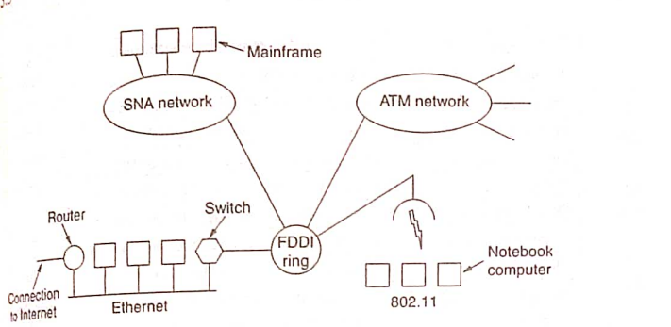
Internetworking
System Network Administrator Networks (SNA)
Asynchronous Transfer Mode (ATM)
Ethernet networks-802.3
Token Bus Networks-802.4
Token Ring Networks-802.5
Fiber Distributed Data Interface (FDDI) networks
802.11 Wireless networks-Wi-Fi technologies- 2.4 GHz- 9.6 Gbps
802.16 Wireless networks-WiMax Technologies-2.5 GHz - 24 GHz
The purpose of interconnecting all these networks is to allow user on any of them to communicate with other networks globally.

Slide 6
How Networks Differ
Item | Some possibilities
Service Offered | Connection oriented versus Connectionless
Protocols | IP, IPX, SNA, ATM,MPLS, AppleTalk
Addressing | Flat (802) Vs Hierarchical (IP)
Multicasting | Present or Absent
Packet Size | Every network has its own maximum
Quality of Service | Present or absent; Many different kinds.
Error handling | Reliable, ordered, and unordered delivery
Flow Control | Sliding Window, Rate control other or none
Congestion Control | Leaky Bucket, Token Bucket, RED, Choke Packets
Security | Privacy rules, Encryption
Parameters | Different Timeouts, flow specifications
Accounting | By connecting time, by packet, by byte, or not at all.

Slide 7
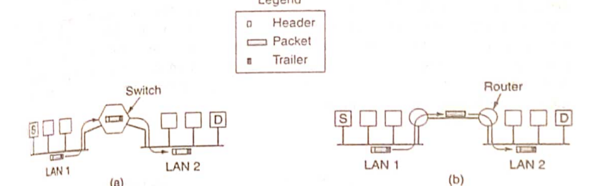
How Networks Can be Connected
The source S wants to send a packet to the destination D. These machines are on different Ethernets, connected by a switch. S encapsulates the packet in a frame and sends it on its way.
The frame arrives at the switch, then determines the frame has to go to LAN2 by referring MAC address. The switch removes the frame from LAN1 and deposits it on LAN2.

Slide 8
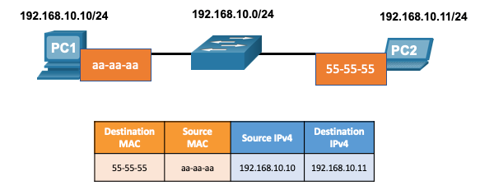
How Networks Can be Connected
There are two primary addresses assigned to a device on an Ethernet LAN:
Layer 2 physical address (the MAC address) – Used for NIC to NIC communications on the same Ethernet network.
Layer 3 logical address (the IP address) – Used to send the packet from the source device to the destination device.
Layer 2 addresses are used to deliver frames from one NIC to another NIC on the same network. If a destination IP address is on the same network, the destination MAC address will be that of the destination device.

Slide 9
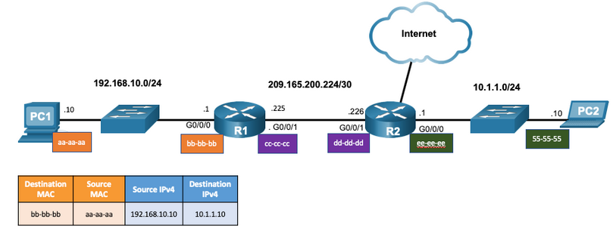
How Networks Can be Connected
When the destination IP address is on a remote network, the destination MAC address is that of the default gateway.
ARP is used by IPv4 to associate the IPv4 address of a device with the MAC address of the device NIC.
ICMPv6 is used by IPv6 to associate the IPv6 address of a device with the MAC address of the device NIC.

Slide 10
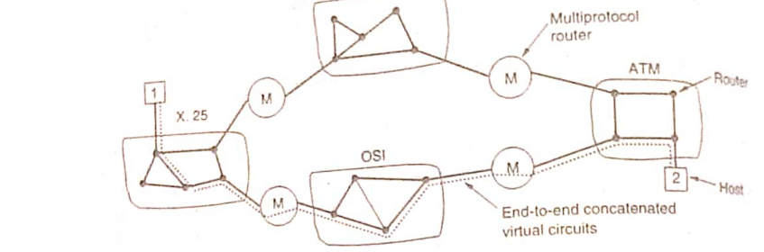
Concatenated Virtual Circuits
In the concatenated virtual circuit, a connection to a host in a distant network is set up similar to connections are normally established.
The subnets sees that the destination is remote and builds a virtual circuit to the router nearest to the destination network.
Then it constructs a virtual circuit from that router to an external gateway. This gateway records the existence of the virtual circuit in its table and proceeds to build another virtual circuit to a router in the next subnet.

Slide 11
Concatenated Virtual Circuits
Once data packets begin flowing along the path, each gateway relays incoming packets, converting between packet formats and virtual circuit numbers as needed.
All data packets must traverse the same sequence of gateways. Packet in a flow are never recorded by the network.
Concatenated virtual circuit are also common in the transport layer.
It is possible to build a pipe using SNA, which terminates in a gateway and have a TCP connection go from the gateway to the next gateway.
This way, an end-to-end virtual circuit can be built spanning different networks and protocols.

Slide 12
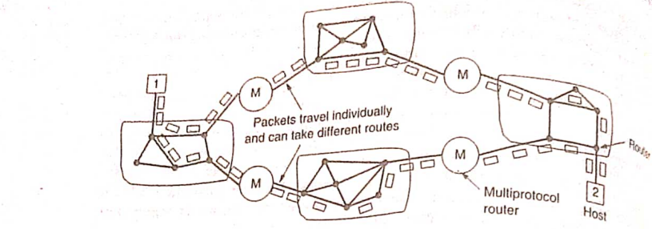
Connectionless Internetworking

Slide 13
Connectionless Internetworking
Connectionless internetworking refers to a method of transmitting data across interconnected networks without establishing a dedicated, continuous connection between the sender and receiver. This approach contrasts with connection-oriented internetworking, where a persistent connection is established before data transmission begins.
Packet Switching: Connectionless internetworking relies on packet switching, where data is broken down into packets (or datagrams) for transmission. Each packet contains destination address information and is routed independently through the network.
No Prior Setup: Unlike connection-oriented networks (like circuit-switched networks), connectionless networks do not require setting up a dedicated path or maintaining state information between sender and receiver before data transmission.
Datagram Networks: Connectionless internetworking is often associated with datagram networks, where each packet (datagram) is treated independently. Examples include networks using the Internet Protocol (IP), where IP packets are routed based on destination addresses without establishing a prior connection.
Flexibility: Connectionless networks offer flexibility because each packet can follow a different path through the network, depending on current network conditions and routing decisions made by routers.
Efficiency: Connectionless internetworking can be more efficient for transmitting bursty or sporadic data traffic because there is no overhead associated with establishing and maintaining connections.

Slide 14
Connectionless Internetworking
Examples: The Internet is a prominent example of a connectionless internetwork, where data is transmitted using protocols like IP.
Each packet is independently routed across multiple networks (routers) until it reaches its destination, where they are reassembled if necessary.
Reliability: Connectionless networks rely on higher-layer protocols (such as TCP over IP) to provide reliability and error recovery mechanisms.
For instance, TCP (Transmission Control Protocol) ensures that packets are received in the correct order and retransmits lost packets if necessary.
In summary, connectionless internetworking offers flexibility, efficiency, and scalability for transmitting data across complex networks like the Internet.
It is a fundamental concept in modern networking, enabling diverse applications and services to communicate seamlessly across interconnected networks.

Slide 15
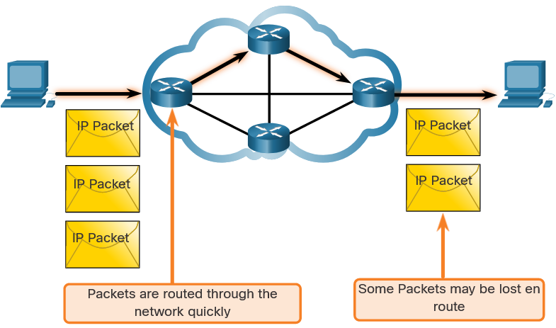
Connectionless Internetworking
IP is Best Effort
IP will not guarantee delivery of the packet.
IP has reduced overhead since there is no mechanism to resend data that is not received.
IP does not expect acknowledgments.
IP does not know if the other device is operational or if it received the packet.

Slide 16
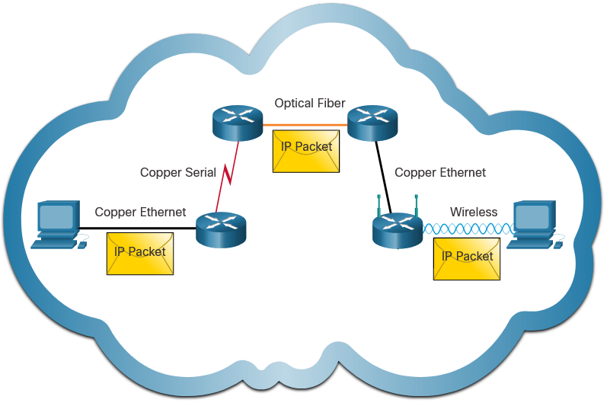
Connectionless Internetworking
IP is unreliable:
It cannot manage or fix undelivered or corrupt packets.
IP cannot retransmit after an error.
IP cannot realign out of sequence packets.
IP must rely on other protocols for these functions.
IP is media Independent:
IP does not concern itself with the type of frame required at the data link layer or the media type at the physical layer.
IP can be sent over any media type: copper, fiber, or wireless.

Slide 17
Connectionless Internetworking
The network layer will establish the Maximum Transmission Unit (MTU).
Network layer receives this from control information sent by the data link layer.
The network then establishes the MTU size.
Fragmentation is when Layer 3 splits the IPv4 packet into smaller units.
Fragmenting causes latency.
IPv6 does not fragment packets.
Example: Router goes from Ethernet to a slow WAN with a smaller MTU

